Slide 1
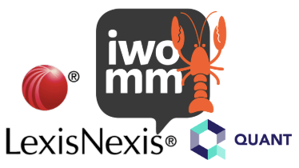
Welcome to IWOMM
London – 13th February 2019

Slide 2
Exploring The Blockchain: using Overledger®
Notes:
To be used as a holding slide whilst doing doing a handover/swapping around on stage.

Slide 3
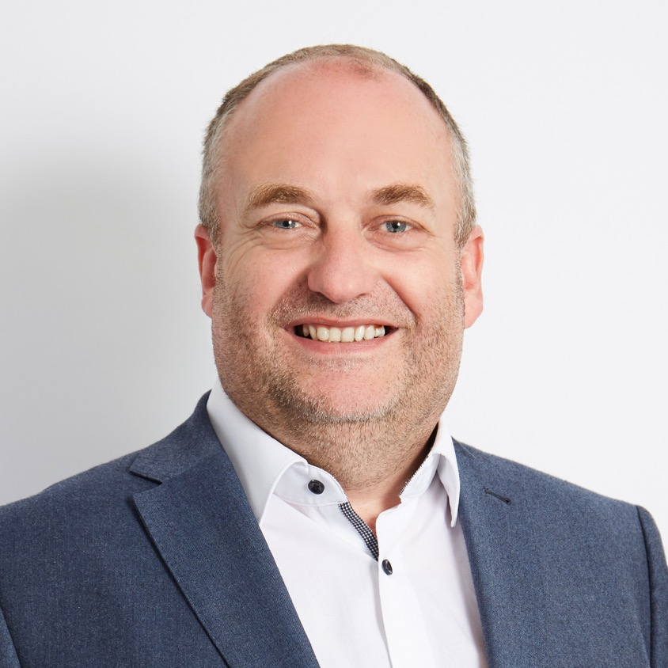














Jean-Paul de Jong Chief Architect
Notes:
All about me, myself and I ☺

Slide 4
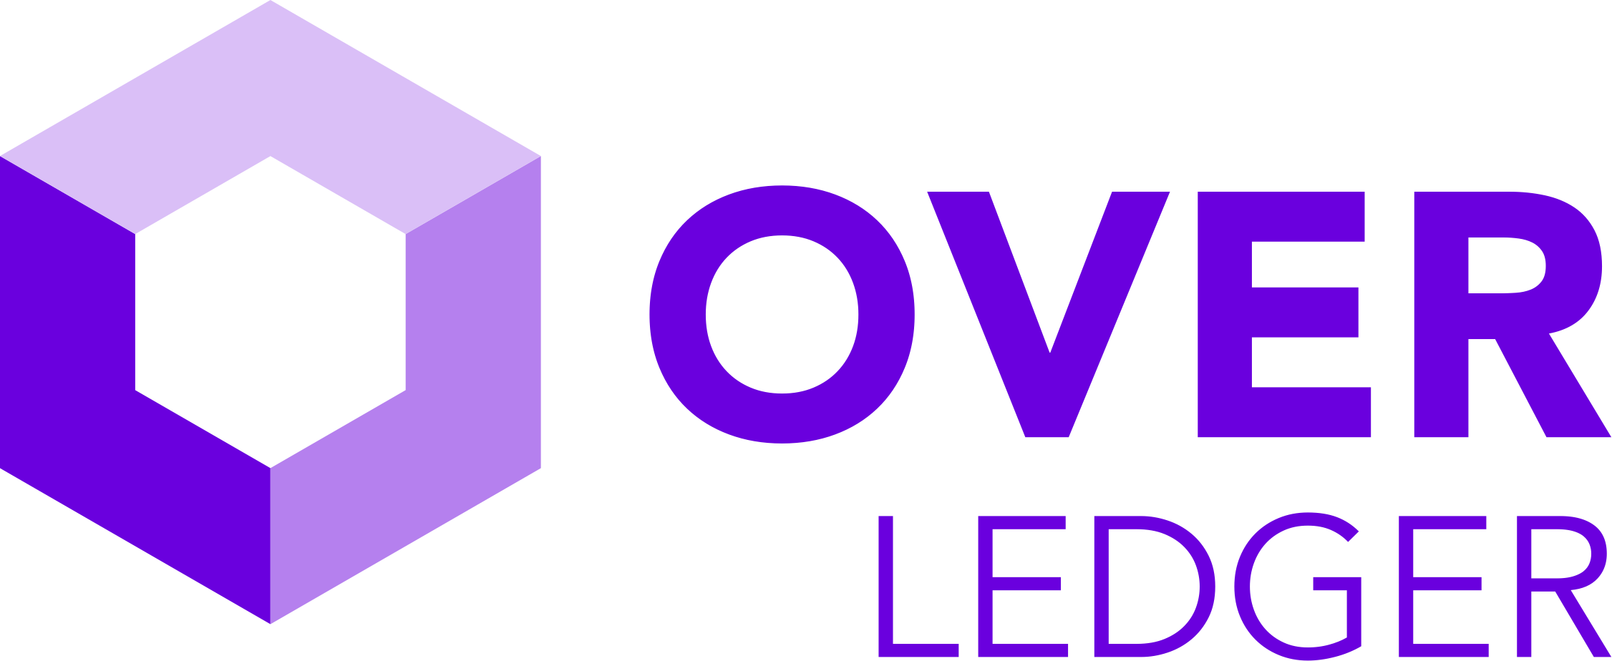
Exploring Overledger
The journey of multichain development
Overledger features
Let’s build something
Recap
Notes:
Introduction of what will be covered.

Slide 5
The Journey of Multichain Development

Slide 6
Environment(s)
Development
Recreate one or more local blockchains if corporate build allows
Alternatively connect to one or more public testnet’s
Request test ‘coins’ from public faucets
Duplicate for Test and Production environments
Networking, Support, Updates etc

Slide 7
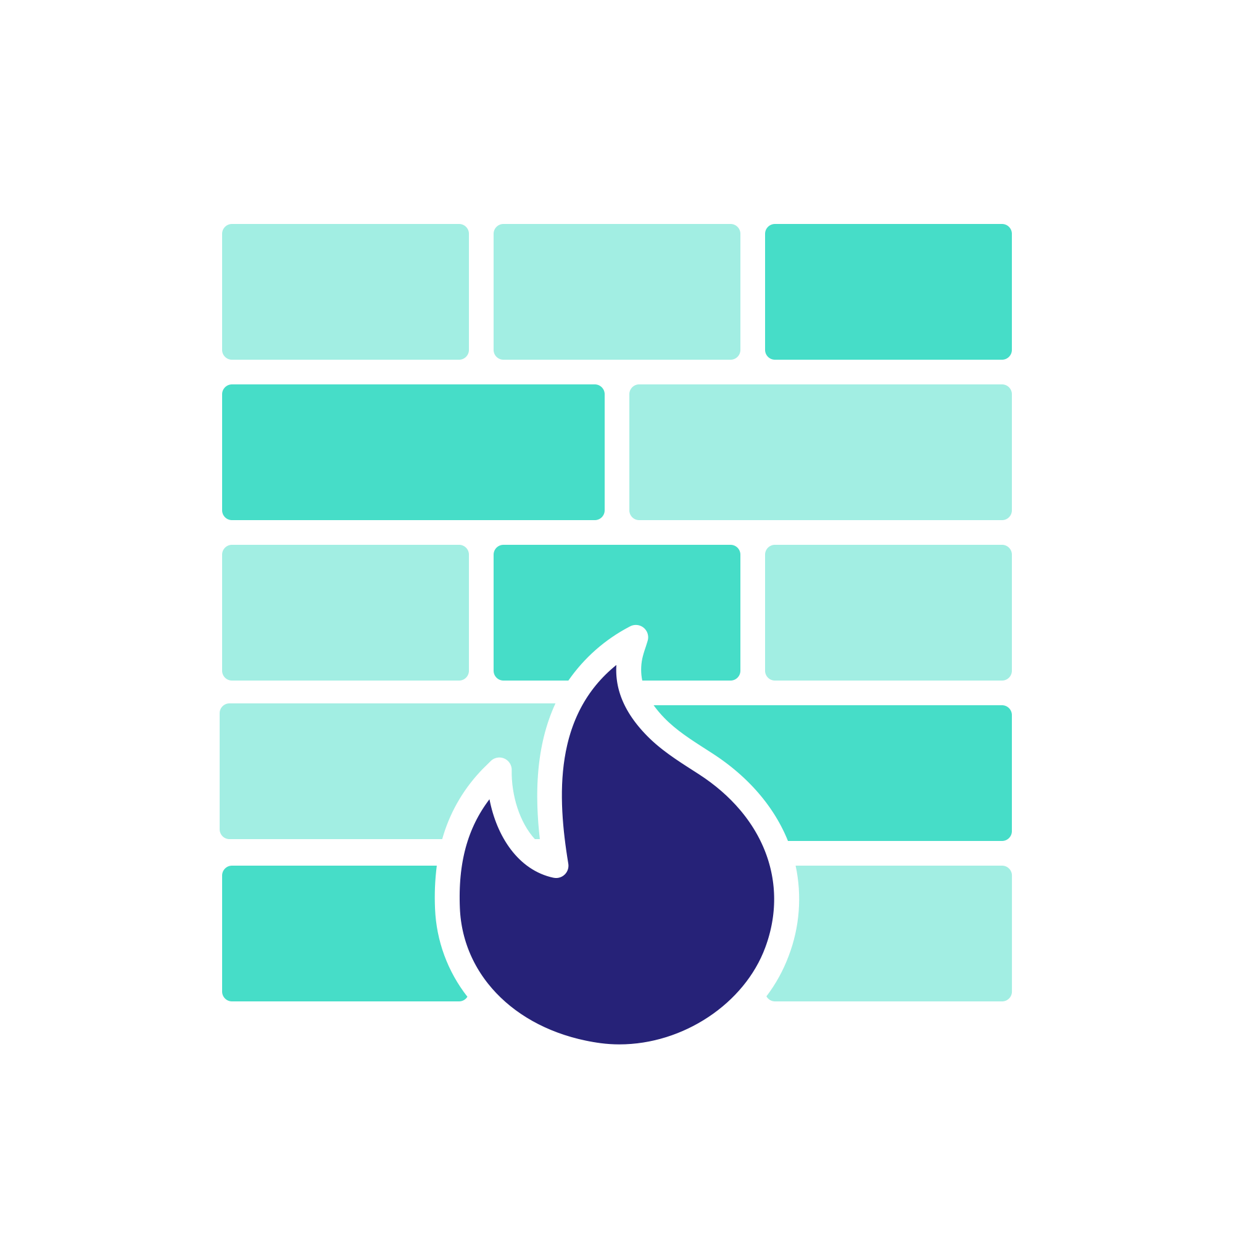

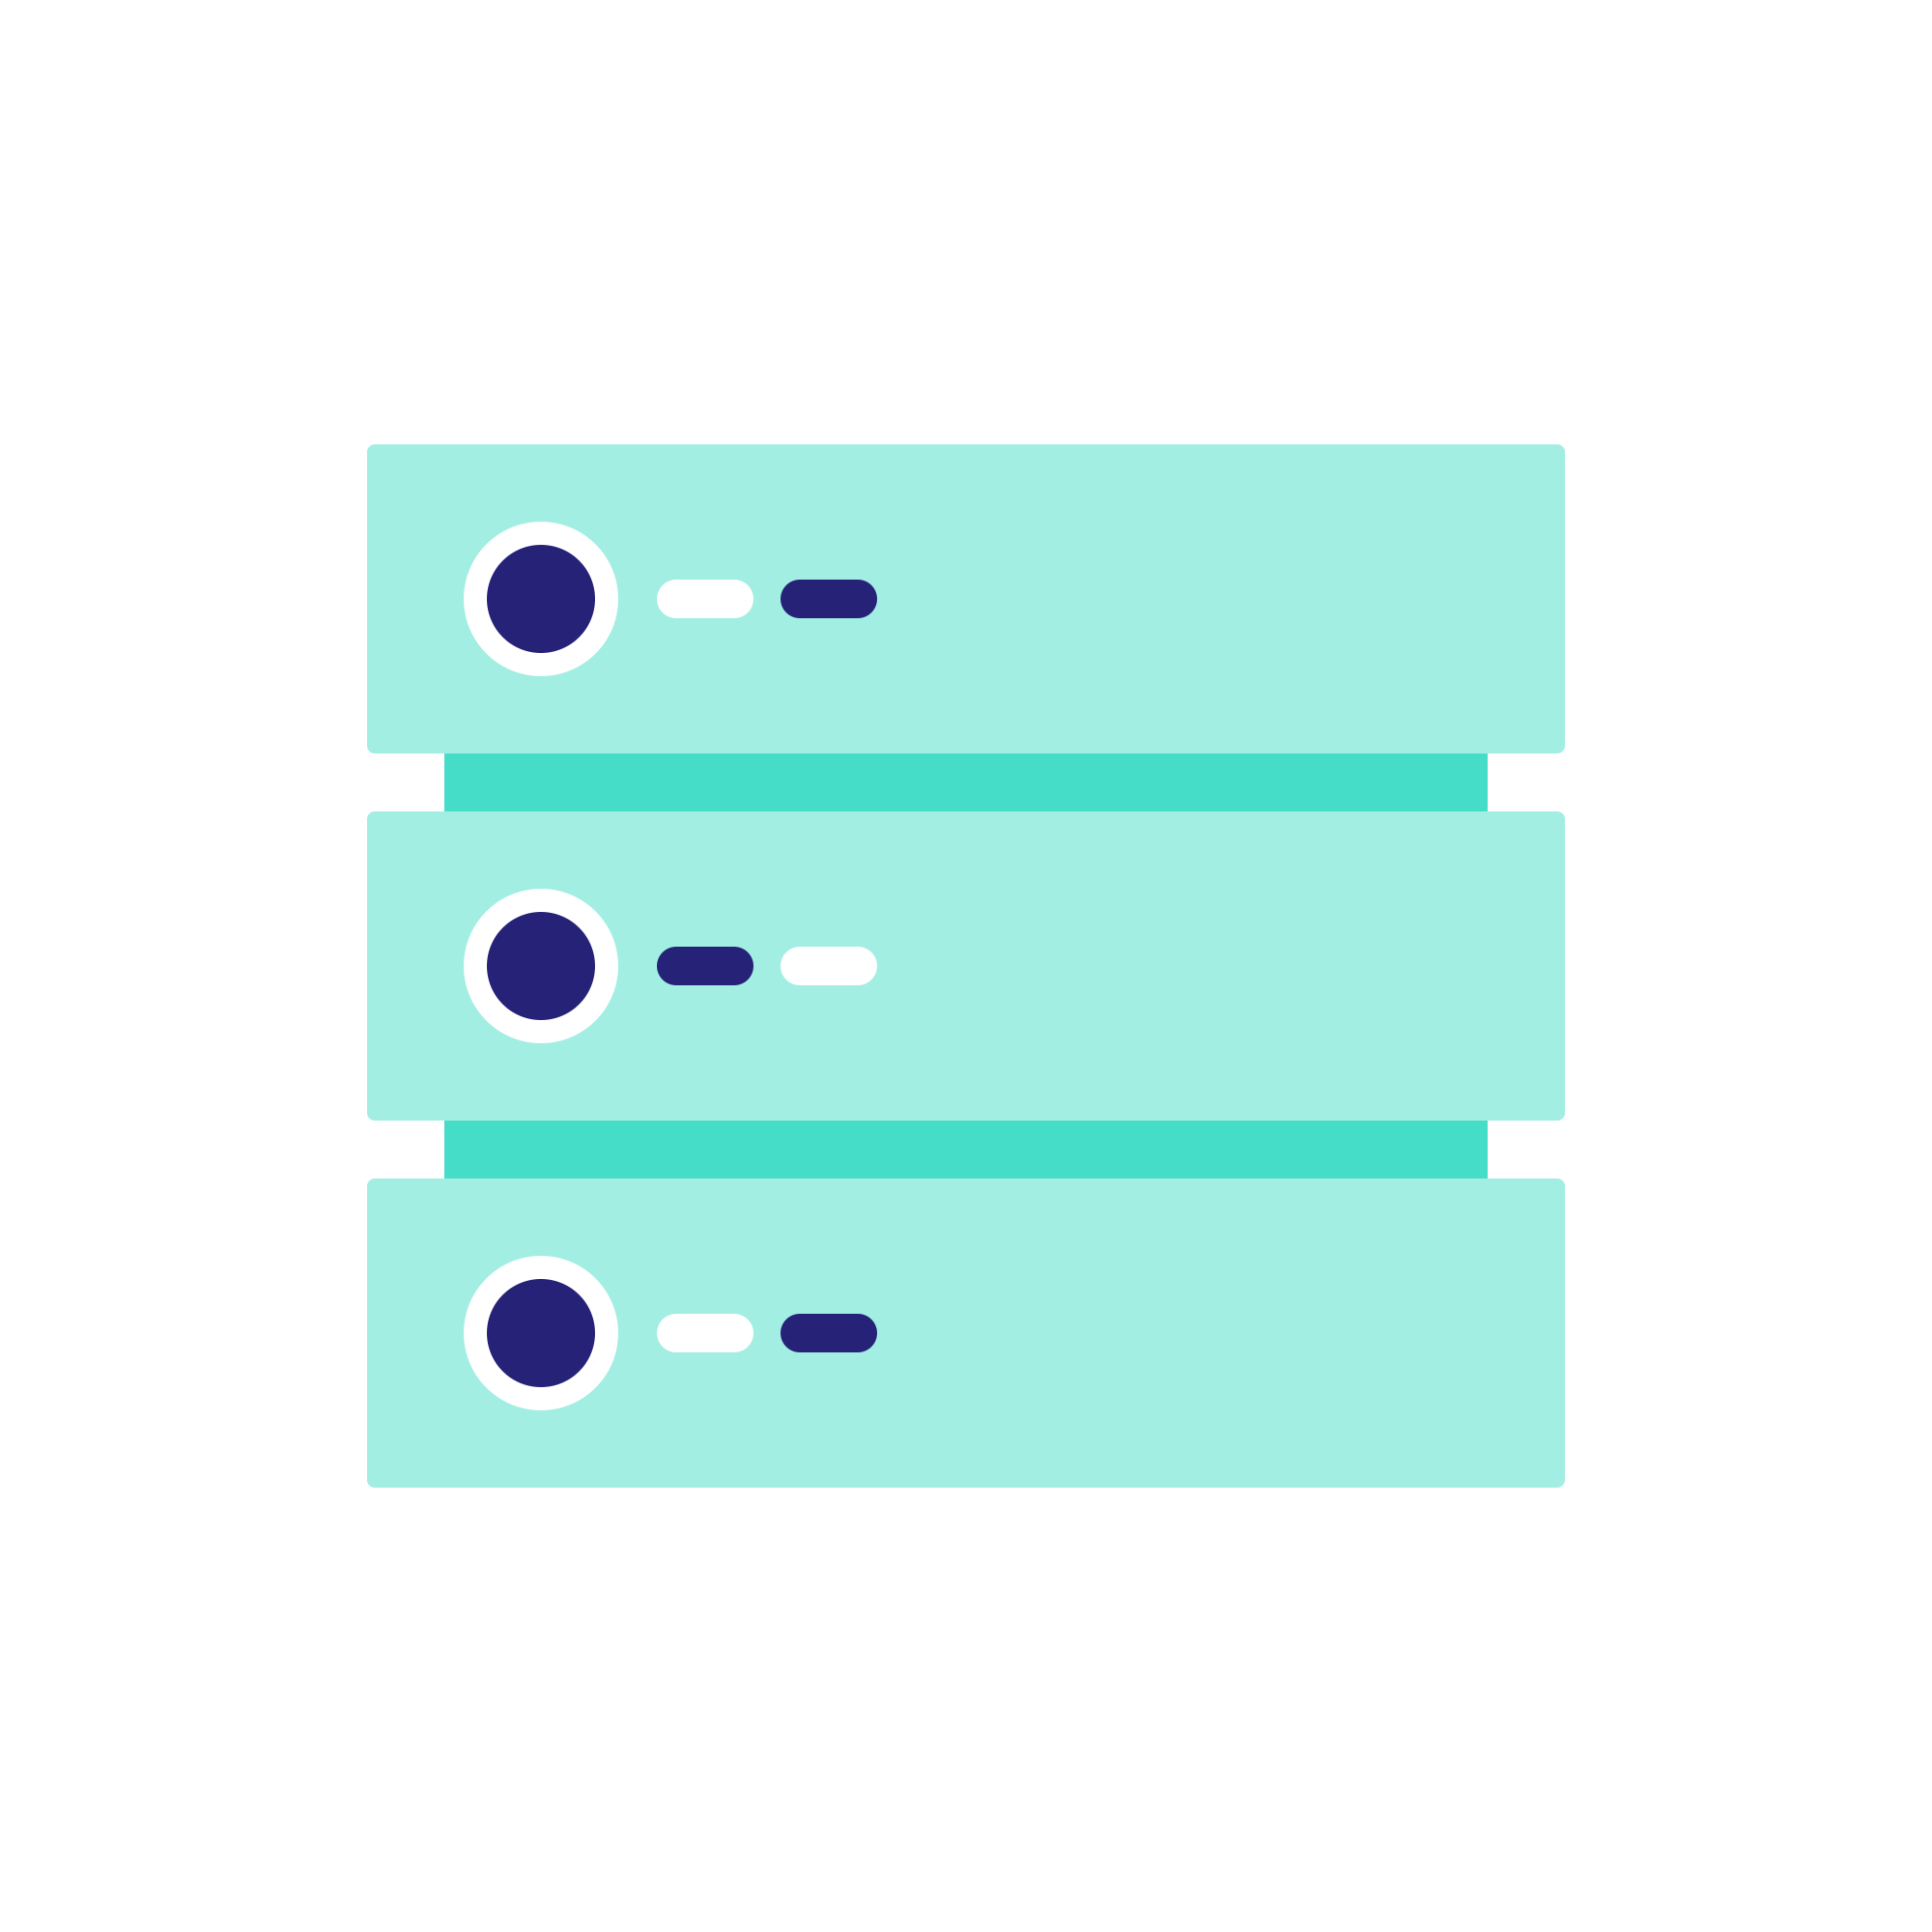
Typical Enterprise Environment
common services
bitcoin
ripple
ethereum

Slide 8
Typical Enterprise Production Environment
Dev
Test
Staging
Production

Slide 9
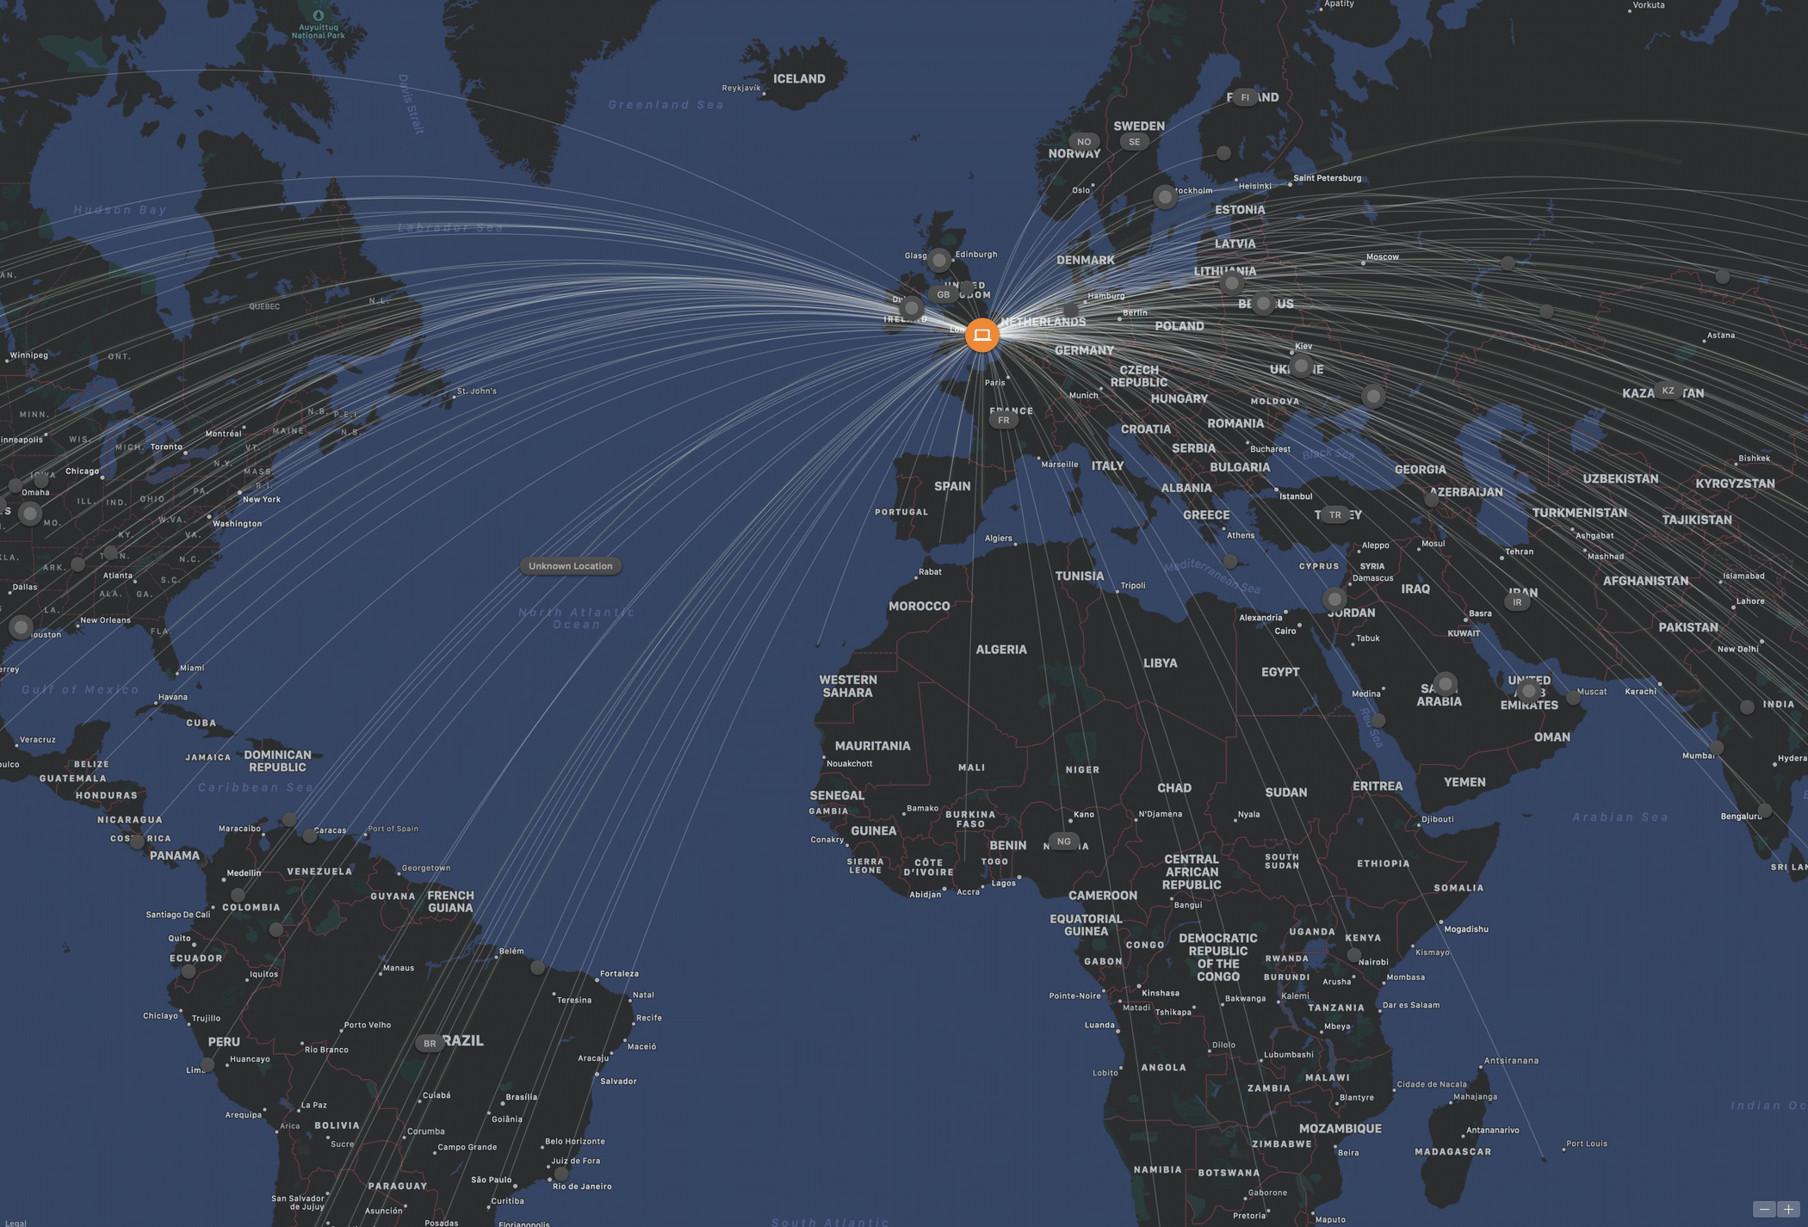

Slide 10


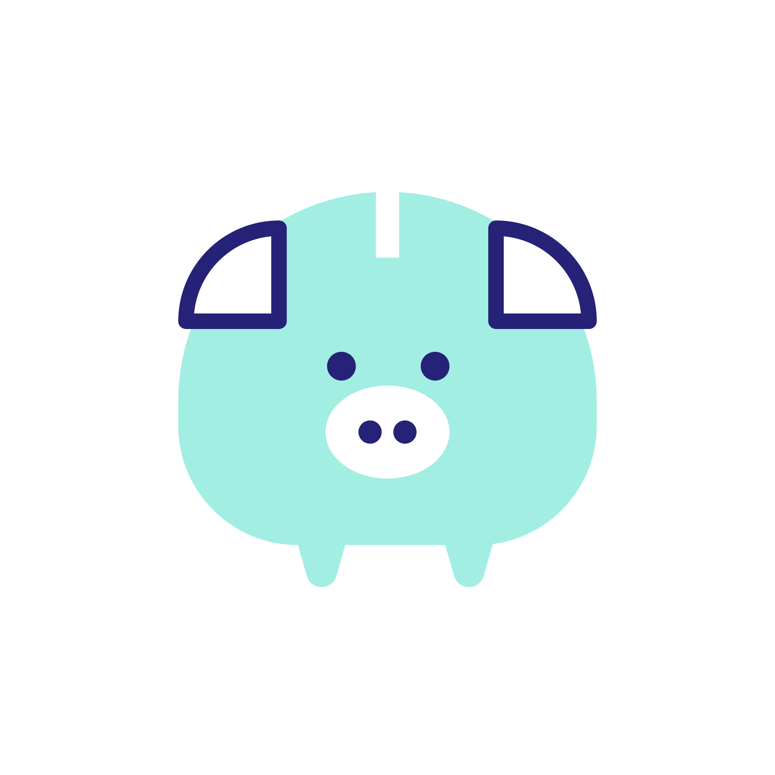
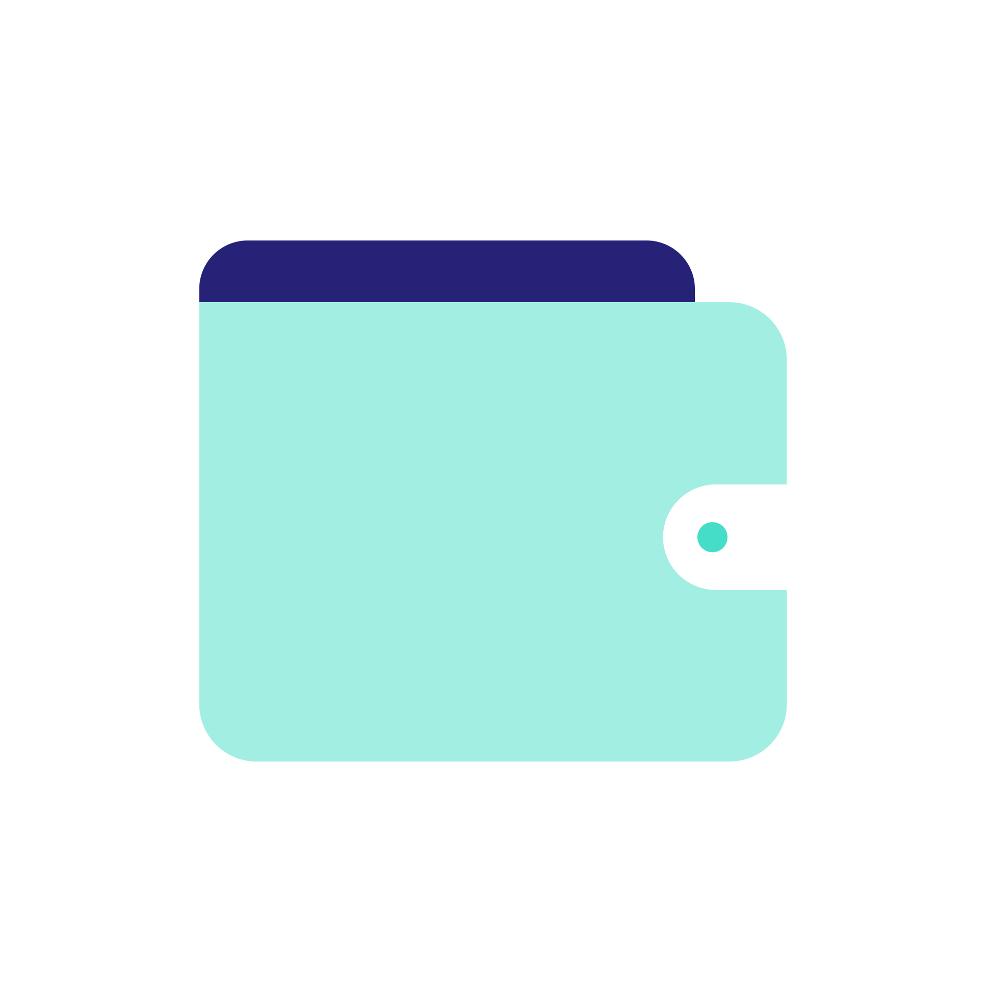


Overledger Features

Slide 11


Overledger : An OS overlay to Interconnect blockchains and networks
Openness – Open-source Java & JavaScript SDKs and Connectors
Interoperable – Connect any network to any network without overhead or limits
Create an ecosystem to foster innovation
Overledger
1st Generation of Blockchains
N^{th} Generation of Blockchains
Other Blockchains
Existing Networks
Cardano
Bitcoin
IOTA
Polkadot
Stellar
ARC
Hyperledger
ICON
Ethereum
Ripple
NEO
AION
JPM QUORUM
Cosmos
CORDA

Slide 12

OS Components
Multi-chain Applications
Multi-chain Applications
Multi-chain Applications
Software Development Kits (SDKs)
Java
Java Script
Built out per market demand
Middleware
Blockchain Programming Interface (BPI)
Handles core read/write across chains
Provides faucets to ease development/test
More complex services – queuing, routing, consolidation
DLT Connectors
Bitcoin
Ethereum
Ripple
Hyper-Ledger
IOTA
Quorum
Quorum
Built out per market demand
Quorum

Slide 13

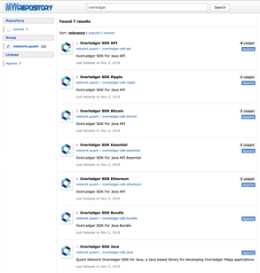
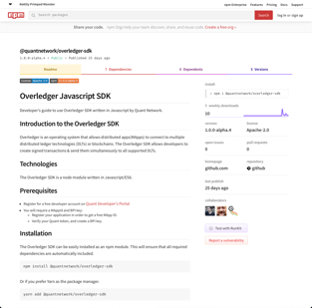
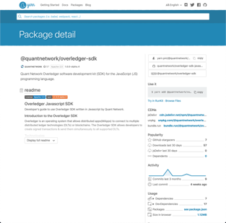
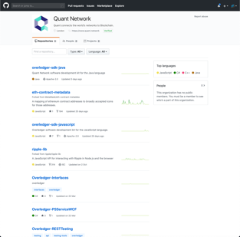
Our SDKs:

Slide 14
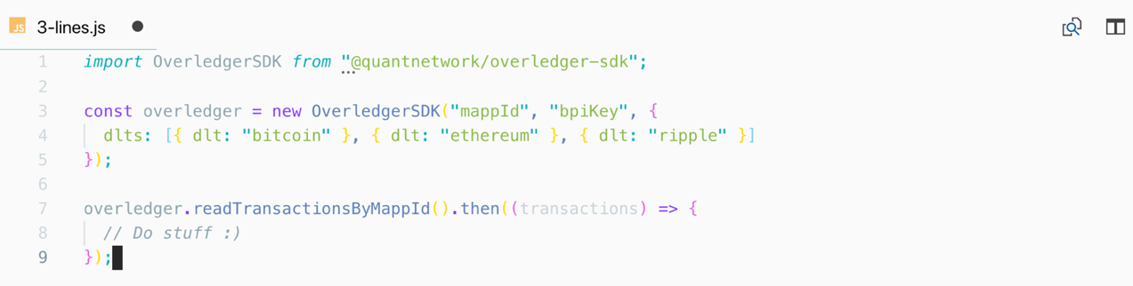
Overledger: Just 3 Lines of Code

Slide 15
101 Dream Cars
Laptops open and let’s build something

Slide 16

101 Dream Cars
A one stop shop for dCommerce
In a single transaction a buyer can
Purchase a car using Bitcoin
Register a car using Ripple
Insure a car using Ethereum

Slide 17
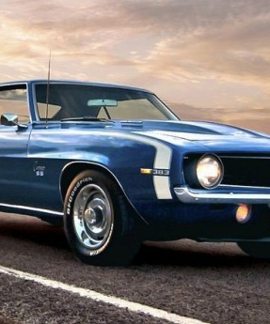
Application Flow / Outline
Setup the shop methods
Create/Fund addresses
Check balances
Create the car buyer methods
Create/Store/Fund bitcoin address
Check balance
Buy a car
Continue shop methods
Get transactions by Tx
Register and insure a bought vehicle
Create/Sign/Send multi-chain transaction
Get transactions by MappId

Slide 18
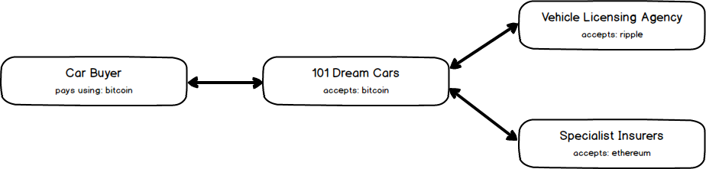
High level overview

Slide 19
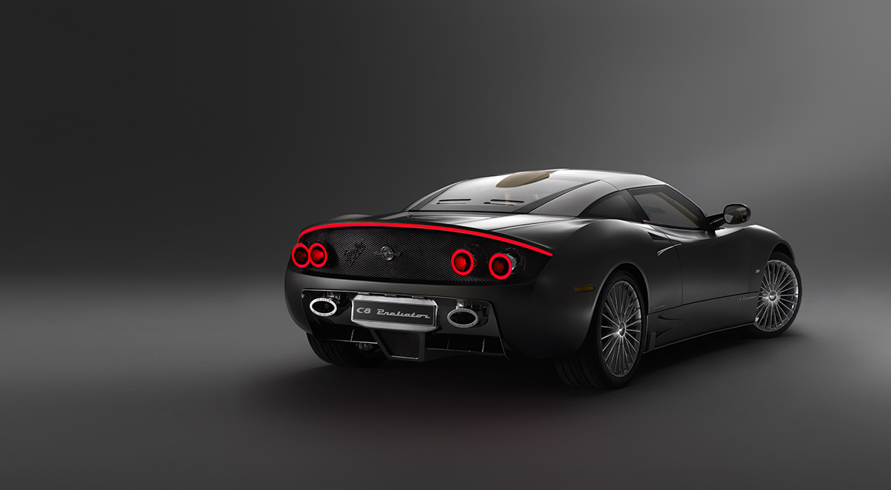
Let’s go
https://github.com/quantnetwork/event-iwomm-blockchain

Slide 20


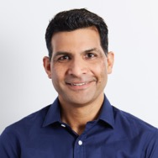





Talk To Us
Notes:
Provided context regarding the challenges of multichain development
Highlighted the ease with which Overledger facilitates multichain development
Presented an overview of our tools available today
Developer Portal, SDKs, mApp store, Overledger
Demonstrated a mApp providing an dCommerce solution
Demonstrated a mApp utilizing multichain search
Indicated what is coming up

Slide 21
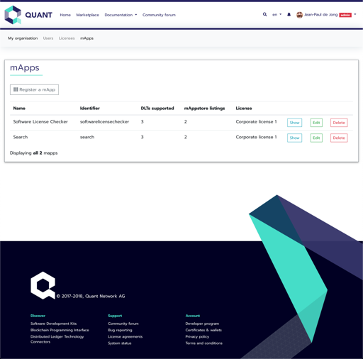
Developer Portal
https://developer.quant.network
Developer & Organisation registration
mApp registration
Quant token verification
Generate Overledger access keys
Publish mApps on Marketplace
Community forums

